Slide 1


Slide 2
Overview
Reionization: What it is and why it’s important.
Escape Fraction: Why you should care about this happy little parameter.
My work: How I’ve explored the importance of the escape fraction on reionization.

Slide 3
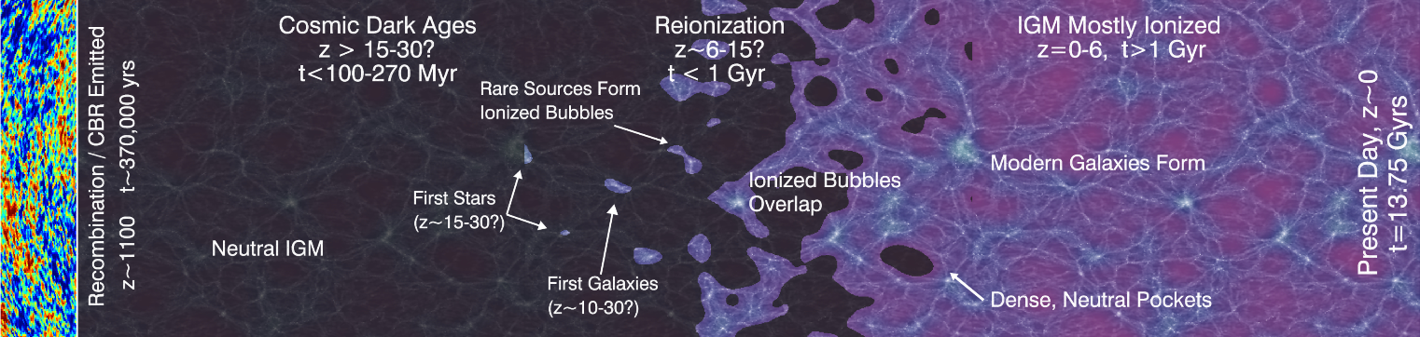
Epoch of Reionization
(Robertson, 2010)
Notes:
Introduce epoch of reionization; give basic outline of timeline. “Start with recombination and then eventually dark matter perturbations grow and form into stars. These stars release ionizing photons etc. “
*Click* “What do we know about EoR? Honestly nearly nothing. Escape fraction (give definition) varies from 0.01 to 0.8 and has debate over behaviour with respect to halo mass. Topology whether high or low density is ionized first. Sources, recently been a resurgence of quasars being considered.”
“How then do we constrain these as observations are difficult? Segue into sims.”

Slide 4
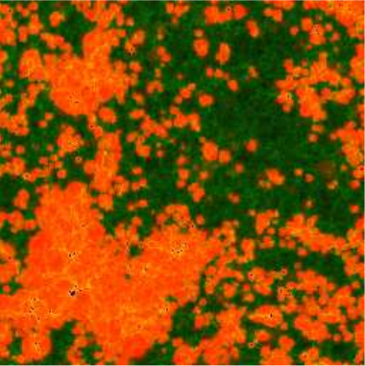
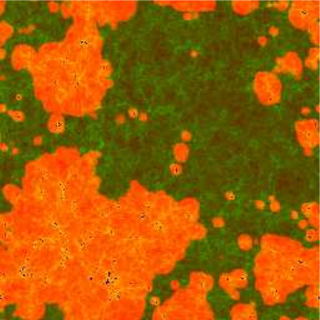
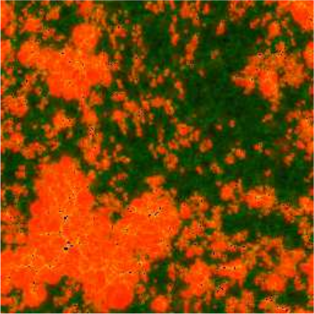
Duration + Topology of Reionization
Fiducial
z_{50%} = 9.8, z_{100%} = 8.5
No Suppression
z_{50%} = 13.9, z_{100%} = 12.9
Low Efficiency
z_{50%} = 7.7, z_{100%} = 6.7
(Iliev et al., 2011)
Notes:
All of these plots show ionized regions at the same ionized fractions, namely when 50% of the box is ionized. However even though these slices have the same ionized fraction, both the topology and epochs they are ionized are vastly different. This highlights that different choices of parameters can greatly alter the procession of reionization especially its duration.

Slide 5
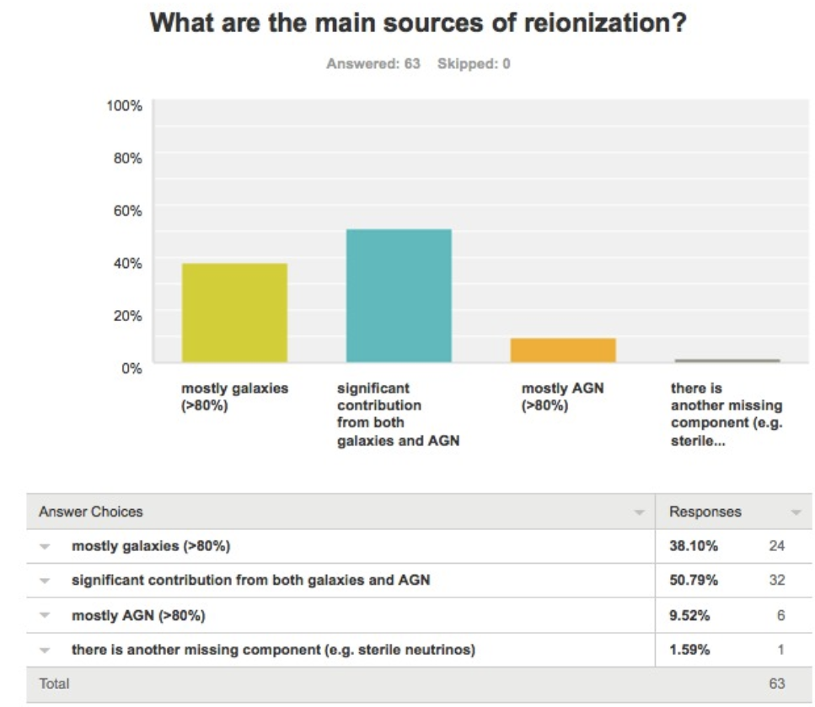
Sources of Reionization
(Fan, 2016)

Slide 6

What is f_{esc}?
𝜸
𝜸
IGM
ISM
𝜸
𝜸
ISM
IGM
𝜸
𝜸
ISM
𝜸
𝜸
ISM
𝜸
ISM
IGM
f_{esc} = $\frac{Number of HI Ionizing Photons that Escape into IGM}{Number of HI Ionizing Photons emitted}$

Slide 7
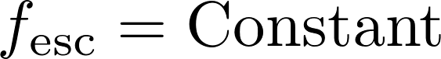
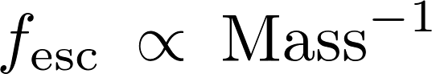

Why is f_{esc} important?
The form of f_{esc} can drastically affect the topology and duration of reionization.

Slide 8
f_{esc} Measurements
At high redshift IGM opacity prevents direct measurement of f_{esc}. Need to use low-z.
z < 1.5: f_{esc} 0-5% (Cowie+ 2009, Grimes+ 2009, Siana+ 2010)
z ~ 4: f_{esc} < 10-20% (Vanzella+ 2015, Guata+ 2016, Grazian+ 2016)
But still loads of disagreement! Some results get measurements > 20%! (Vanzella+ 2015, Guata+ 2016, Grazian+ 2016)
During EoR current requirements are f_{esc}~20%.

Slide 9
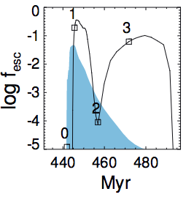
Is f_{esc} A Function of the Individual Galaxy?
Stellar feedback + Supernovae blowouts move gas to outskirts.
Photons can more easily escape into the IGM?
SN Blowout
Radiation Feedback
(Kimm et al., 2016)
Notes:
From zoom-in simulations that also included a sub-grid model of SFR.
M_Part approx 1000 Msun, L approx 4 h^-1Mpc. Spatial res approx 10pc.
These images show the most massive galaxy from a number of different runs. Highlights that there is significant variation in the escape fraction over time and that there is a slight delay between the peaks in SFR and the peaks in fesc.

Slide 10
My Aim
Is it possible to model the Epoch of Reionization using a more physically motivated escape fraction parameterization?*
How does the topology change?
How does the duration change?
Can we observationally discriminate between different escape fractions?
(* Hopefully yes otherwise no Dr. Seiler in the future).
Notes:
Normally people just assume constant escape fraction, however this simiplifies a lot of things (as we just saw). As a consequence, are we able to determine a more physical form of the escape fraction that still agrees with general EoR things?

Slide 11
Semi-Analytic Models
Cold Gas
Star Formation
Cooling
Supernovae Heating
Hot Gas
Incorporation
Ejected Gas
Supernovae Ejection
Infalling Gas
(including
reionization feedback)
+ Black Hole Growth
+ Merger/Disruption Events
+ Bulge Growth
Notes:
Give an overview of how SAMs work. “SAMs work by moving mass through different reservoirs depending upon coupled DEs. The processes are (e.g. supernovas heat cold gas etc etc).”

Slide 12
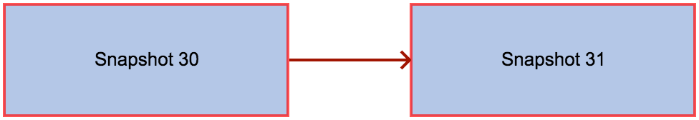
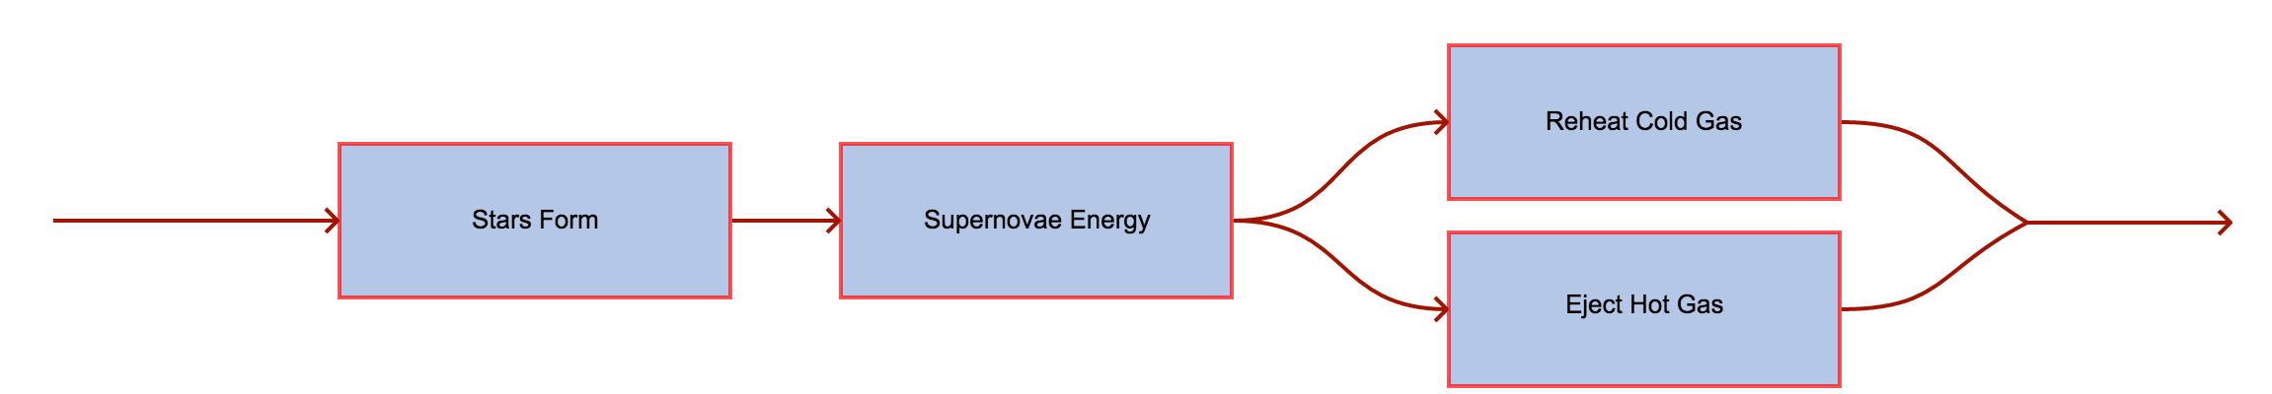
Supernova Feedback
Only valid if snapshots span ~40Myr
Notes:
Normally people just assume constant escape fraction, however this simiplifies a lot of things (as we just saw). As a consequence, are we able to determine a more physical form of the escape fraction that still agrees with general EoR things?

Slide 13
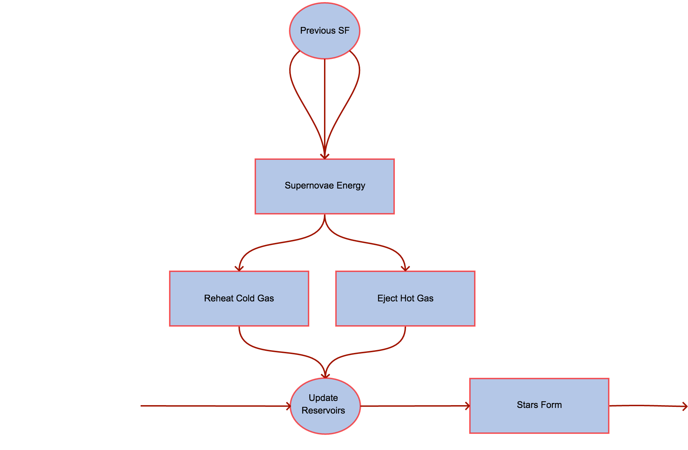
Notes:
Normally people just assume constant escape fraction, however this simiplifies a lot of things (as we just saw). As a consequence, are we able to determine a more physical form of the escape fraction that still agrees with general EoR things?

Slide 14
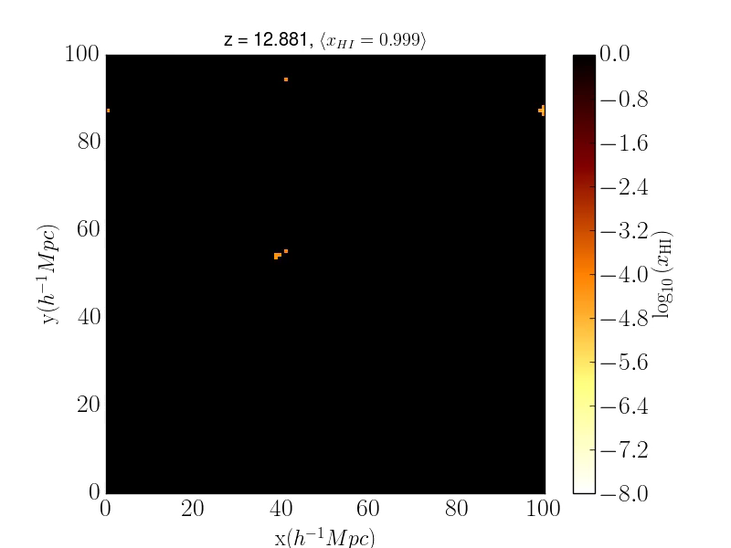
Galaxy Properties + Photons
Model reionization in a post-processing step.
Use SFR to calculate number of ionizing photons.
Draw spheres and count the number of ionizing photons + neutral H + recombinations.
Notes:
A previous talk has hopefully talked about SAMs; if they haven’t give a brief description. On the left is the SMF which we can see agrees to an acceptable level with the observations. On the right we see that the rate of ionizing photons reaches a plateau after ~5 Myr. This is a linear relationship that depends upon the SFR which is how we determine the number of ionizing photons emitted by each galaxy.
Finally highlight that SAMs take a short amount of time to run; easy to explore parameter space!

Slide 15

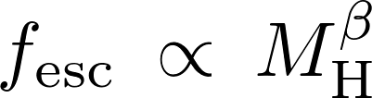




Escape Fraction Parameterization
Sample Text
Notes:
Final ingredient is the escape fraction. In this work we focus on 3 different parameterizations. As we saw the halo mass is thought to affect the escape fraction so we use a power law. We fix the escape fraction for the least and most massive halos that then defines our slope + intercept. The ejected mass is an attempt to model how SN are seen to affect the escape fraction. Fix the smallest and largest escape fraction and then define a linear relationship.
But because of the power of the SAM we can really be crazy and parameterize the escape fraction however we want. These are just a few examples.

Slide 16
Preliminary Results
Notes:
Link back to observations. Explain contours properly. What we do and don’t know about obs

Slide 17
Preliminary Results
Notes:
Link back to observations. Explain contours properly. What we do and don’t know about obs

Slide 18
Summary
f_{esc} is a complex combination of parameters depending upon galaxy properties.
Using galaxies evolved from a Semi-Analytic Model, we implement a more physical prescription for f_{esc}.
Our key assumption is that f_{esc} depends strongly on the density of the galaxy gas.
Attempt to capture this by using halo mass and ejected fraction.
Important consequence is that since these parameters evolve, the escape fraction will evolve as well.
Notes:
It’s a summary slide, do I really need to summarize the summary?

